Slide 1


Lenoir-Rhyne University Convocation Program Database

Slide 2
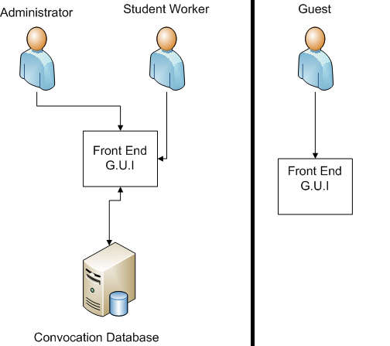
Access Permissions

Slide 3
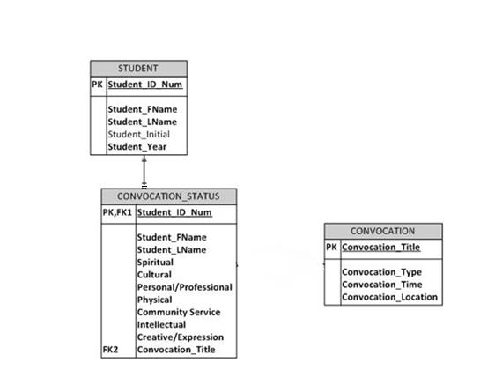
Entity Relationship Diagram

Slide 4
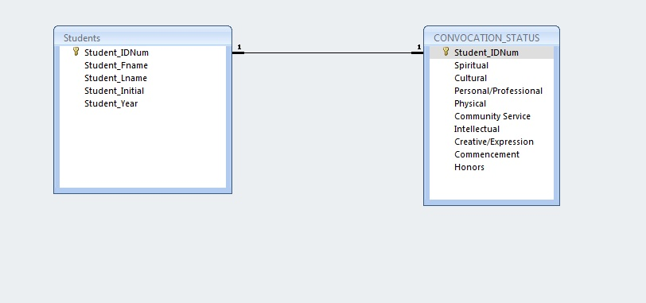
Relationship Model in Access

Slide 5
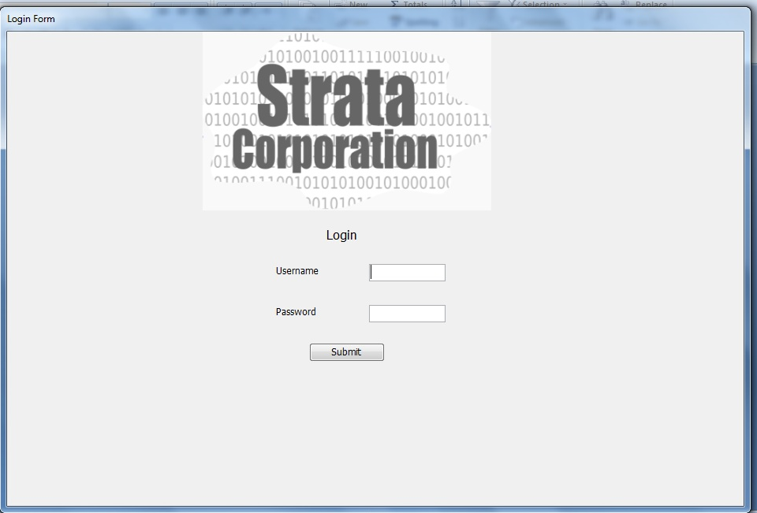
Login

Slide 6
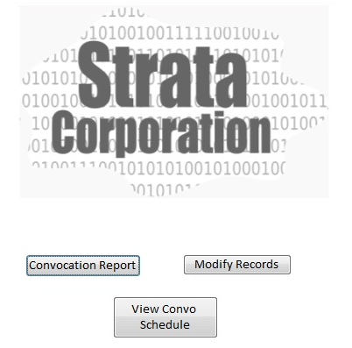
Student Screen

Slide 7
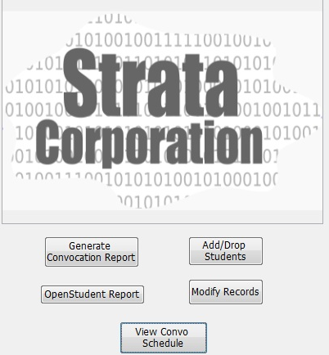
Admin Screen

Slide 8
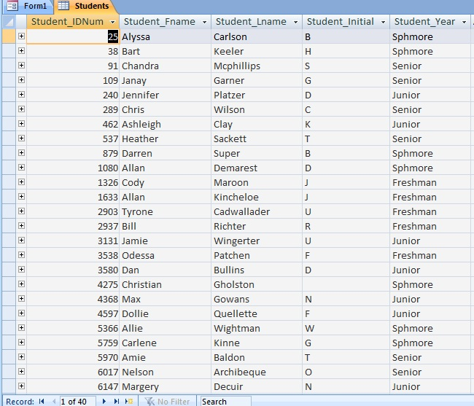
Student Table

Slide 9
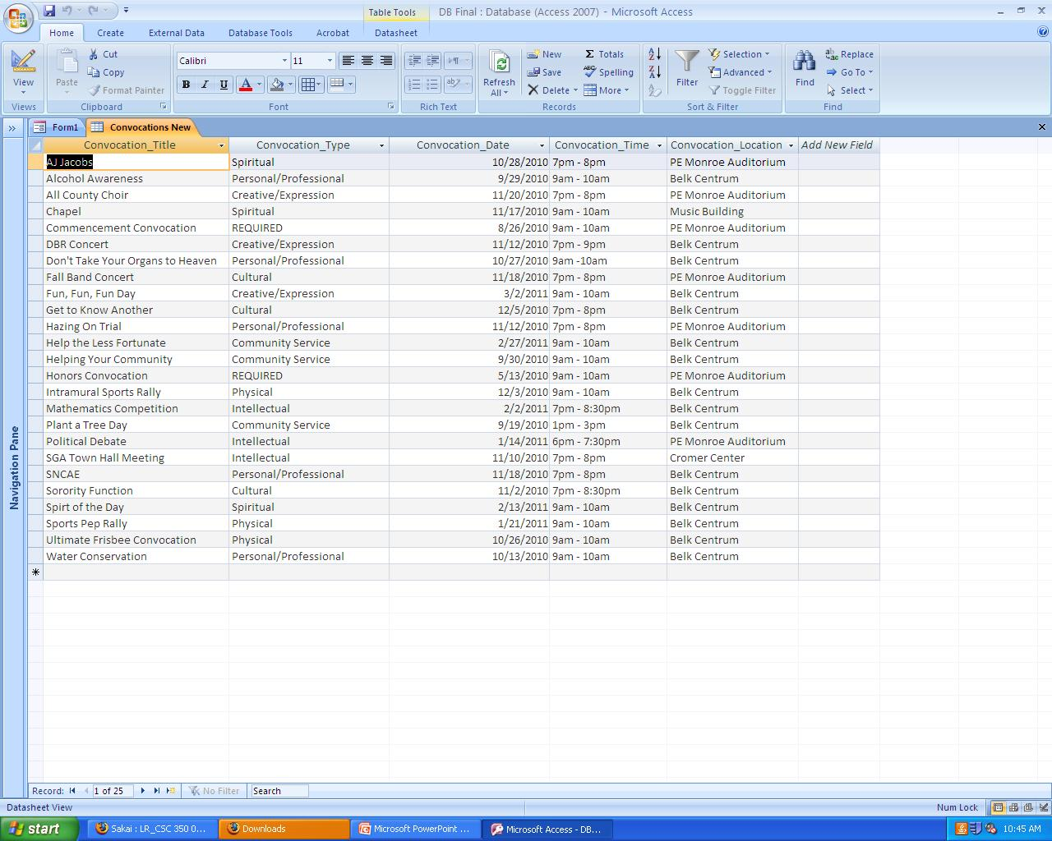
Convocation Schedule
Hazing On Trial | Personal/Professional | 11/12/2010 | 7pm - 8pm | PE Monroe Auditorium
Chapel | Spritual | 11/17/2010 | 9am - 10am | Music Building
DBR Concert | Creative/Expression | 11/12/2010 | 7pm - 9pm | Belk Centrum
Fall Band Concert | Cultural | 11/18/2010 | 7pm - 8pm | PE Monroe Auditorium
Water Conservation | Personal/Professional | 10/13/2010 | 9am - 10am | Belk Centrum
Don't Take Your Organs to Heaven | Personal/Professional | 10/27/2010 | 9am -10am | Belk Centrum
SNCAE | Personal/Professional | 11/18/2010 | 7pm - 8pm | Belk Centrum
Alcohol Awareness | Personal/Professional | 9/29/2010 | 9am - 10am | Belk Centrum
All County Choir | Creative/Expression | 11/20/2010 | 7pm - 8pm | PE Monroe Auditorium
Helping Your Community | Community Service | 9/30/2010 | 9am - 10am | Belk Centrum
AJ Jacobs | Spiritual | 10/28/2010 | 7pm - 8pm | PE Monroe Auditorium
Sorority Function | Cultural | 11/2/2010 | 7pm - 8:30pm | Belk Centrum
Plant a Tree Day | Community Service | 9/19/2010 | 1pm - 3pm | Belk Centrum
Ultimate Frisbee Convocation | Physical | 10/26/2010 | 9am - 10am | Belk Centrum
SGA Town Hall Meeting | Intellectual | 11/10/2010 | 7pm - 8pm | Cromer Center
Commencement Convocation | REQUIRED | 8/26/2010 | 9am - 10am | PE Monroe Auditorium
Honors Convocation | REQUIRED | 5/13/2010 | 9am - 10am | PE Monroe Auditorium
Intramural Sports Rally | Physical | 12/3/2010 | 9am - 10am | Belk Centrum
Get to Know Another | Cultural | 12/5/2010 | 7pm - 8pm | Belk Centrum
Political Debate | Intellectual | 1/14/2011 | 6pm - 7:30pm | PE Monroe Auditorium
Sports Pep Rally | Physical | 1/21/2011 | 9am - 10am | Belk Centrum
Mathematics Competition | Intellectual | 2/2/2011 | 7pm - 8:30pm | Belk Centrum
Spirt of the Day | Spiritual | 2/13/2011 | 9am - 10am | Belk Centrum
Help the Less Fortunate | Community Service | 2/27/2011 | 9am - 10am | Belk Centrum
Fun, Fun, Fun Day | Creative/Expression | 3/2/2011 | 9am - 10am | Belk Centrum

Slide 10
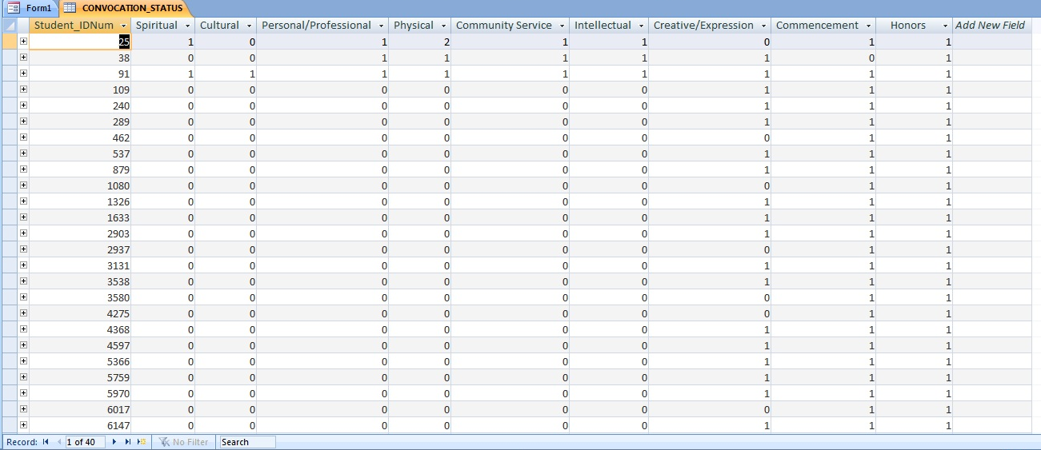
Convo Status Table

Slide 11
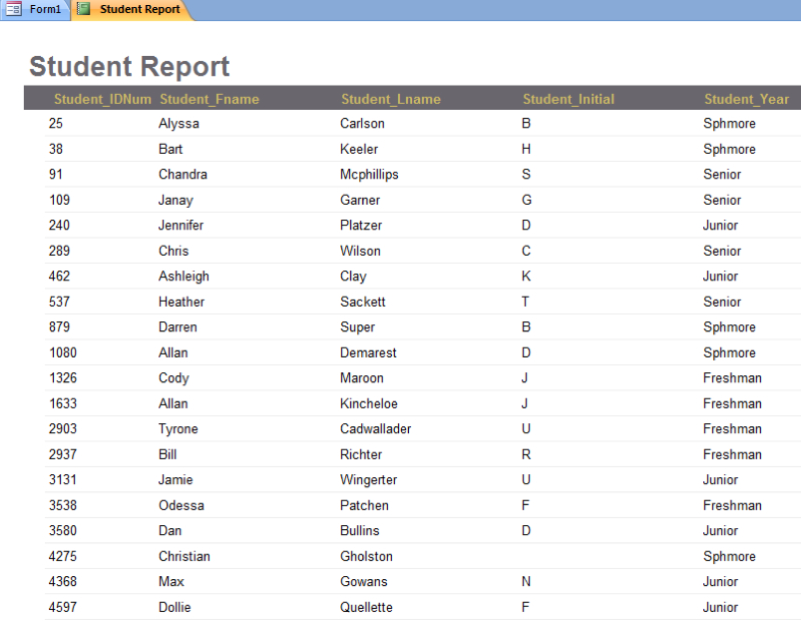
Report 1

Slide 12
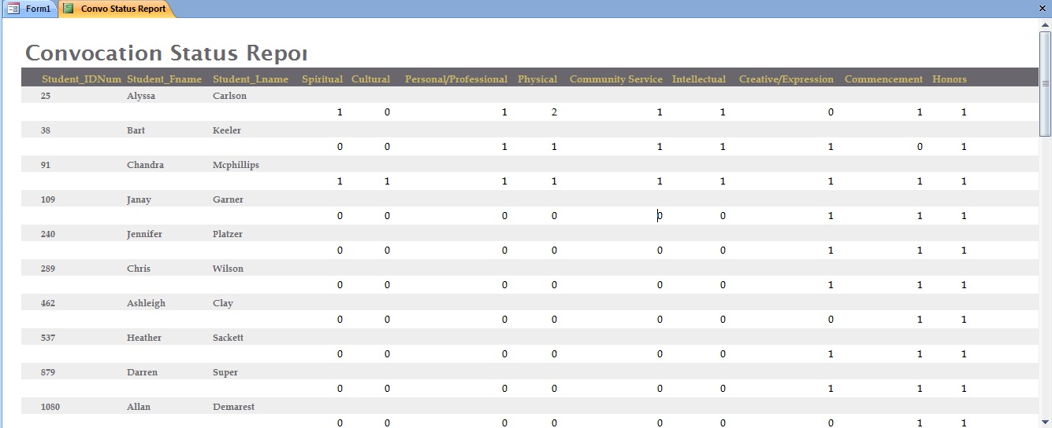
Report 2

Slide 13
Staff
Stacy Brown: Documentation Specialist, Project Manager
Cameron Chandler: Assistant Project Manager
Brandon Harwood: Database Administrator
Alfred McCorkle: Business Analyst
Darin Philyaw: Graphical User Interface Designer
Kelsey Willett: Data Representative

